Slide 1
Using Geoprocessing Services with the ArcGIS JavaScript API
By Caleb Mackey and Nate Christ

Slide 2
What is a Geoprocessing Service?
A Geoprocessing Service (GP Service) provides data management, conversion, and analytical capabilities as a service through the ArcGIS REST API.
A GP Service represents a published toolbox with a Python script tool or model. It can also be created from a Python Toolbox.
This is useful because the client does not need to have ArcGIS Desktop installed to run a GP Service; it is all ran by the ArcGIS Server in the backend via requests made through the ArcGIS REST API.

Slide 3
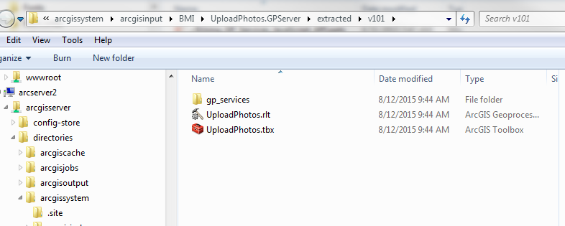
Creating a GP Service
In order to create a GP Service, you must publish the results of tool that has been ran successfully in ArcMap/Catalog
Open Geoprocessing Options > Results > Right click on tool that was ran > Share As > Geoprocessing Service
This will create toolbox locally on the server (arcgissytem/arcgisinput folder) with a single tool inside. The python script will reside here as well.

Slide 4
Testing the GP Tool before Publishing
All input parameters are coming from the client application. What does this mean for input parameter types?
JSON (as String)
Strings
Numbers
Sometimes you need to “trick” the tool with empty JSON just to get the tool to run successfully so you can publish.
Publishing errors can happen due to inputs from the tool that was ran from Desktop. To fix this issue, you can pass in empty JSON and not actually run the tool functionality (arcpy.AddMessage(“Success”))
Only do this if you know it won’t be an issue from the client side

Slide 5
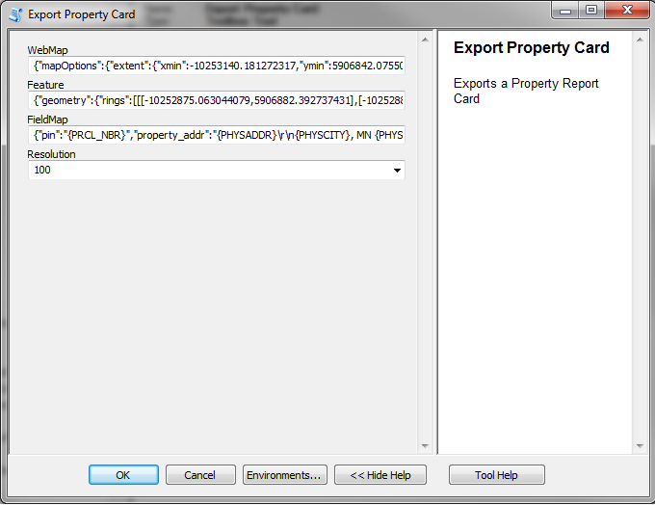
Testing JSON in tool input

Slide 6
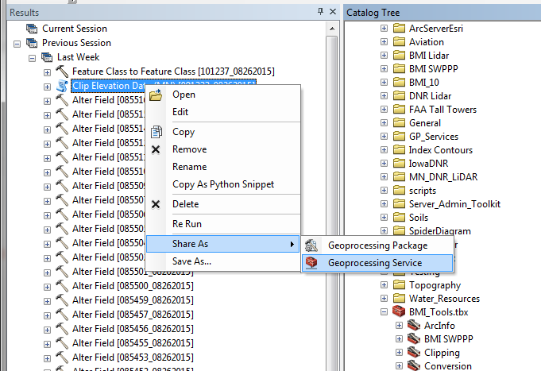
Publishing a GP Service

Slide 7
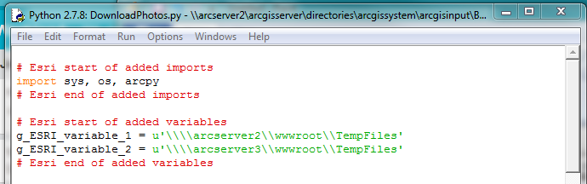
Server-Side Python Script
When a script tool is published, Esri uses an internal validation process to check all variables used in the script. If there are data/folder paths that are hard-coded in the script, a new variable is created.
This is done in case the resource was not previously registered with the data store and data was copied to the server. Therefore, any output folders or data sets used by script should be registered with the data store before publishing.
If any data is copied to the server, the “g_ESRI_variable_x” is changed to that path on the local server.

Slide 8
Server-Side Script Continued
In addition to checking for variables, ArcGIS also checks the script’s imports to make sure modules can be found within the Server’s PYTHONPATH.
If you are using custom or 3rd party module imports, you must make sure they can be imported by all servers within the ArcGIS Server site! Some useful strategies:
Have a custom Python library in a shared location within network. Then you can do one of these things:
Alter the Server10.x.pth file in the site-packages folder within the Python install folder to include the shared library path. You will have to do this every time new version of Server is installed/upgraded.
Failsafe: Use the sys module to temporarily add the shared location to PYTHONPATH within script (removed from PYTHONPATH after script is ran)
sys.path.append(r“\\some_server\shared_py_library”)

Slide 9
Server-Side Script Continued
Third party/custom module import strategies continued:
Package custom module locally with the script in the gp_services folder on Server. However, now you are using a static copy of the custom module. Probably not the best option.
Because ArcGIS Server uses 64-bit Python, make sure any 3rd party modules used are the 64-bit versions.

Slide 10
Server-Side Script Considerations
Although a GP Service is just running a Python script on the backend, there are several important considerations:
ArcGIS Server runs 64-bit Python. What does this mean?
Personal geodatabase data sources and excel spreadsheets cannot be used (because they use a 32 bit driver)
Uses a slightly different arcpy package that is optimized for Server
Cannot use some extensions (spatial, 3D, geostatistical) unless using an Advanced License. No Exceptions! Hint: There are some workarounds for spatial analyst if using image server.
The script must be built to handle different types of input specific to a web environment such as Feature Sets (these are just JSON objects representing a collection of features).

Slide 11
Server-Side Script Considerations Continued
4. Determine whether a GP Service should be Synchronous or Asynchronous:
Synchronous – should be used for operations that execute quickly because the client has to wait for this job to complete (uses execute task).
Single call is made to server
Asynchronous – Should be used by processes that take a long time to complete and the client can do other things while the process is running. This avoids browser time outs (uses submit job).
While a GP Service is running asynchronously, the client makes continuous calls against the GP Job (via the jobID) to check on the status until the task completes (jobStatus = esriJobSucceded).
Repetitive calls made to server to check progress
Cannot use tool validation in the traditional sense. Maybe with a Python toolbox?
1. Probably makes more sense to handle the input parameter validation on the JavaScript/HTML side

Slide 12
Important Concepts
GP Task – single tool that will be ran (Asynchronously or Synchronously)
http://your_server.com/arcgis/rest/services/folder/ToolName/GPServer/ToolName
GP Input – these represent the parameters that need to be passed in to the GP Service Task (as JSON)
Contains info about the parameter such as name, data type, etc.
GP Job – represents a job that was executed by the GP Service.
GP Result – result JSON for a GP Job. If there is an output parameter set in the script, it is returned with the GP Result.
Provides info about the result parameters as well as inputs. Similar to Geoprocessing Results in Desktop or arcpy.Result.

Slide 13
Integration with the ArcGIS JavaScript API
On the Server-Side, the Python script must be able to take arguments from the client (if there are input parameters). How do these get into the script? Use ArcPy!
GetParameter – returns the parameter as an object. Useful for a feature set!
GetParameterAsText – returns a parameter value as a text string.
Note: you can also use the built-in sys module to get parameters as text
paramAsText = sys.argv[1] # first parameter, index 0 is script name
SetParameter – sets an output parameter for a tool from an object.
Very Important, you MUST use this if your tool has an output parameter and you want to access it from the Web Application after the task has ran
SetParameterAsText – sets an output parameter for a tool as a text string

Slide 14
Integration with the ArcGIS JavaScript API
Since we are accessing GP Services through a web client, there is no “out of the box” GUI for the tools like in ArcMap or ArcCatalog.
Note: GP Services can be executed with any programming language that can make REST requests (like Python!)
It is up to the developer to create UI components and client side logic to execute GP Tasks because the parameters need to be passed from the web application to the Python Script. Making use of HTML/CSS/JavaScript functionality is very important!

Slide 15
Calling a GP Service in the JS API
To consume a GP Service, you must use the Geoprocessor class.
The parameters differ for every tool and therefore are passed in as JSON matching the parameter schema as defined in the service.
Tools that return output data are accessed in the geoprocessor’s execute or submit job callback when complete. See getting the results from a GP Service.

Slide 16
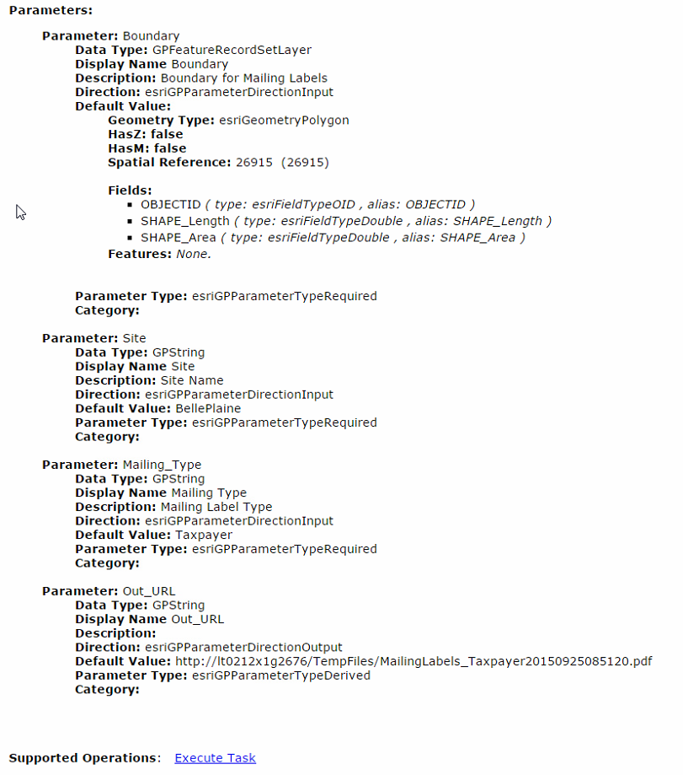
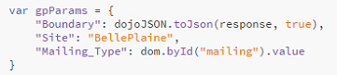
Because the “Out_URL” parameter direction is output, it is derived and is not referenced in the JSON parameter input shown above.

Slide 17
Getting the output from a tool
When the GP Service has finished executing the callback returns two things for both execute (synchronous) and submit job (asynchronous):
results – includes any result data
messages – includes any messages returned during the process (this depends on the message level set for the GP service!)
execute(inputParameters, callback?, errback?)
submitJob(inputParameters, callback?, statusCallback?, errback?)

Slide 18
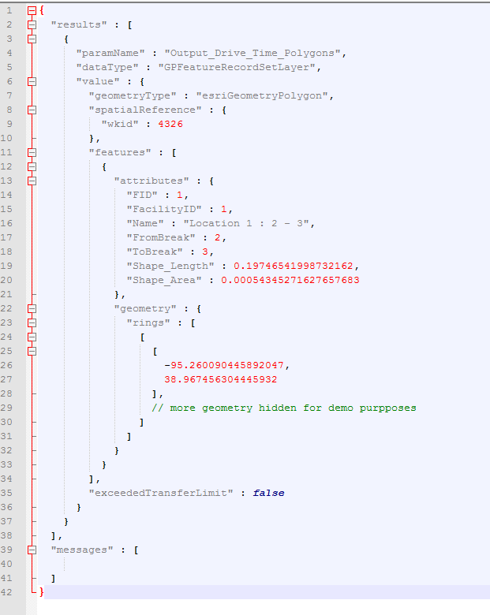
GP Results Response
When calling a GP Service from a REST Endpoint, you can see what the JSON response would look like. When successful, it will return an array of results (usually just one) and messages.

Slide 19
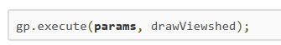
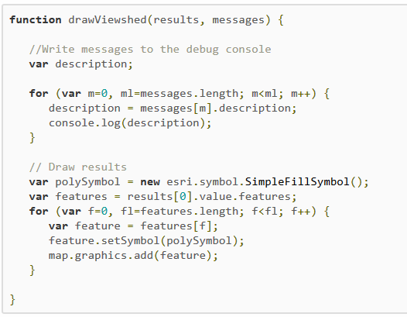
Getting the output from a Synchronous task
This example from the Esri help docs demonstrates how to handle the results. The drawViewshed() function is the callback for when the task has successfully completed (there is also an error callback function that can be used as a third parameter of the Geoprocessor.execute() method). The output parameter in this case is a Feature/Record Set.

Slide 20
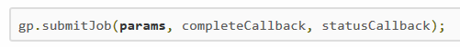
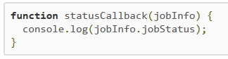
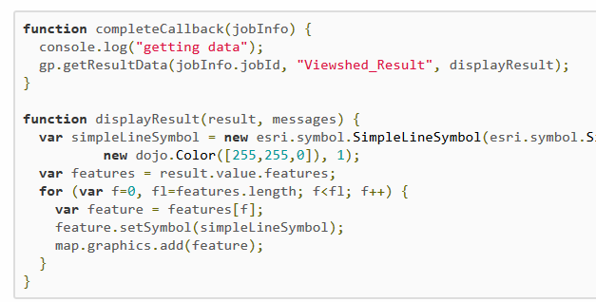
Getting the output from an Asynchronous task
There is a slightly different process when handling results from an Asynchronous process. While the job is executing, the GP framework will make repeated calls to the service to check the status (statusCallback() function will print out any messages along the way) until the job has completed.
If the job has completed successfully, a jobInfo object is returned. The jobId from the jobInfo object is then passed into the getResultData() method from the Geoprocessor where the second parameter is the output parameter name and the third parameter is the callback to do something with the output parameter.

Slide 21
Questions?
calebma@Bolton-menk.com
natech@Bolton-menk.com
Workshop Materials
https://github.com/Bolton-and-Menk-GIS/GPServices_Workshop_2016
References
https://developers.arcgis.com/javascript/jsapi/
http://resources.arcgis.com/EN/HELP/MAIN/10.1/index.html#/Parameters/01540000054v000000/GUID-39A6B08B-4A90-4556-B922-42DF00529BD7/

